Slide 1
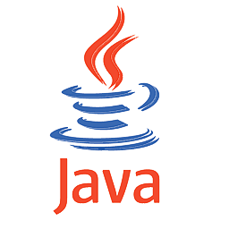
Object Oriented Programming with Java
by
Dr. S.F.Rodd, Professor,
Department of Computer Science and Engineering

Slide 2

Contents
History and Evolution of Java
Buzz-words and attributes of Java
JDK, JRE, JVM
Structure of a Java Program
Program compilation
5. Data Types – Primitive & Non-Primitive
6. Alternate Array declaration
7. Array references
Arrays – Multi-Dimensional Arrays
10. Language constructs – Loops and Control statements
11. Strings and Command-line arguments

Slide 3

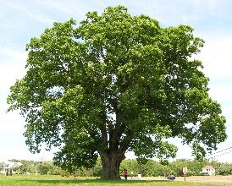

History of JAVA and its Evolution
Java was developed by James Gosling of Sun Microsystems in the year 1995
The original name of Java was Oak, however it was renamed as Java due to legal conflict with Oak Software Systems.
Java was named after an island called JAVA in Indonesia which renowned for growing coffee..
The first version of Java …. Java 1.0 was released in January 1996

Slide 4
History of JAVA and its Evolution
The Latest version of Java …. Java 14.0 and is now available on oracle website as Sun Microsystem was acquired by Oracle Corporation in the year 2010 for 7 Billion dollars
For Netbeans 8.2 you need to install JDK 8…
Higher versions will have improved built in classes and newer packages.

Slide 5
Java Buzz Words
Java is
1. Simple - Syntax same as that of C/C++
2. Platform Independent – Runs on any OS
3. Architectural Neutral – Runs on any Machine
4. Portable – Write once run anywhere
5. Distributed – Portions of your application can run
on many computers
7. Multi-Threaded – Many execution paths within a
program
8. Robust – Auto-memory management – No pointers
9. Secure – Byte codes are verified before execution

Slide 6



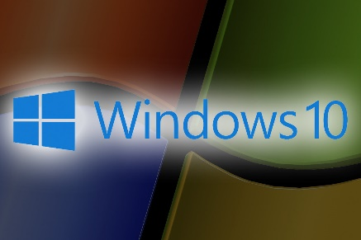
Java Buzz Words
Java is
2. Platform independent – Runs on any OS
A Java program written on one operating system, runs on any other Operating System without any modifications

Slide 7
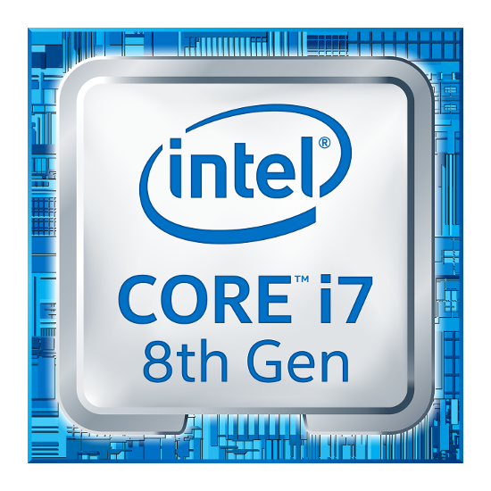
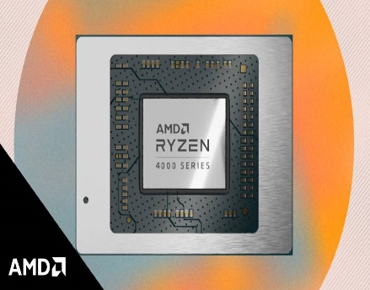
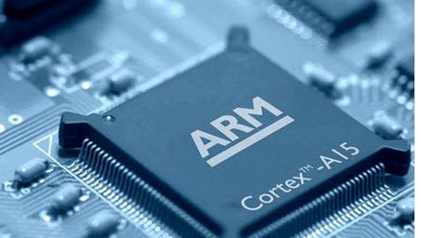
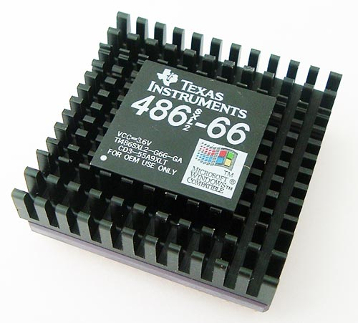
Java Buzz Words
Java is
2. Architectural Neutral – Runs on any Machine
A Java program written on one machine hardware, runs on any other machine hardware without any modifications

Slide 8
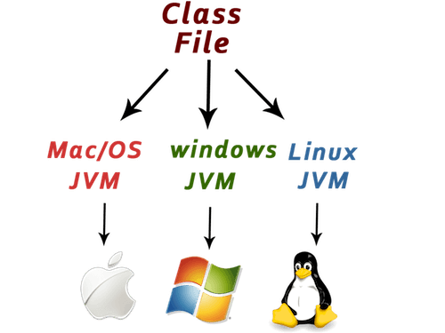
Java Buzz Words
Java is
2. Portable – Write once run anywhere
A Java program written on one operating system, runs on any other Operating System without any modifications

Slide 9
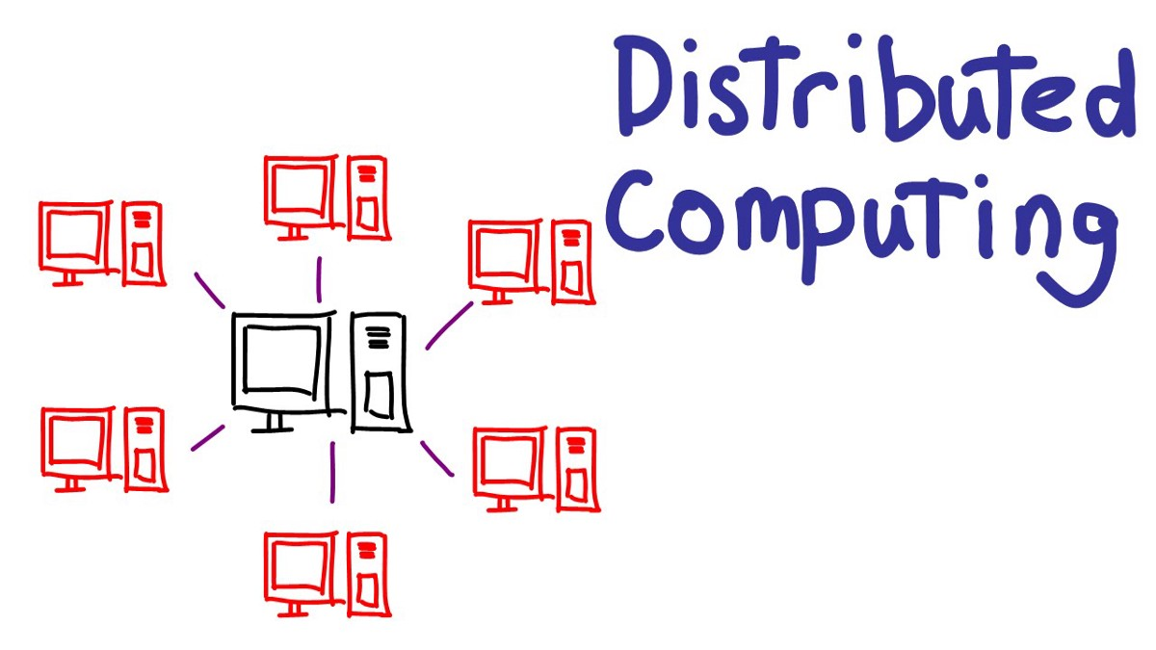
Java Buzz Words
Java is
2. Distributed – Portions of your application can run
on many computers

Slide 10
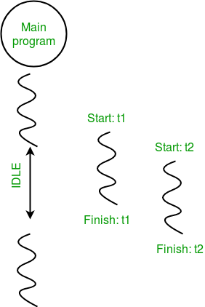
Java Buzz Words
Java is
2. Multi-Threaded – Many execution paths within a
program
Main Thread
Thread 1
Thread 2

Slide 11
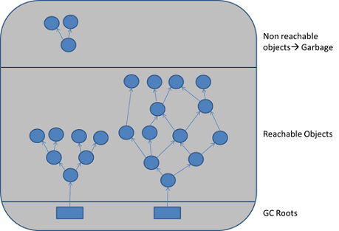
Java Buzz Words
Java is
2. Robust – Auto-memory management – No pointers
Garbage Collector

Slide 12
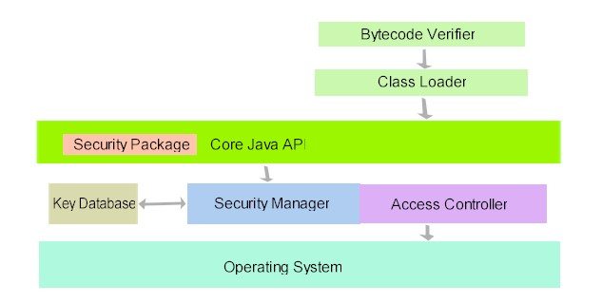
Java Buzz Words
Java is
2. Secure – Byte codes are verified before execution

Slide 13
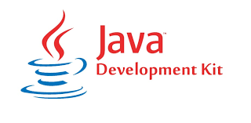
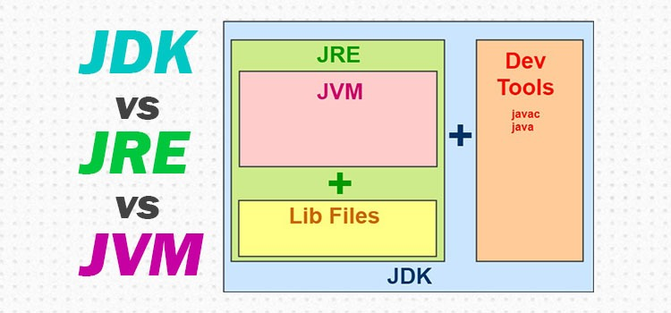
JDK – Java Development Kit

Slide 14
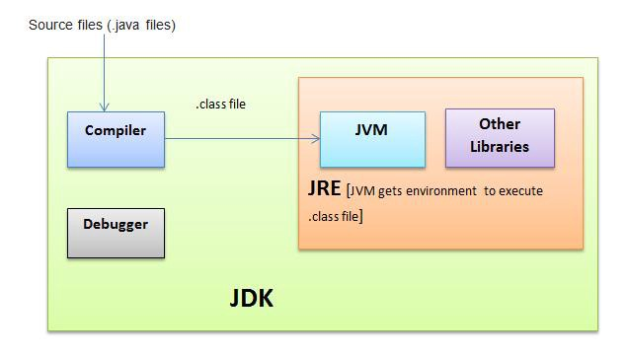
JDK – Java Development Kit

Slide 15
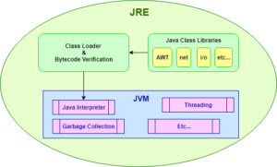
JDK – JRE The Java Runtime Environment

Slide 16
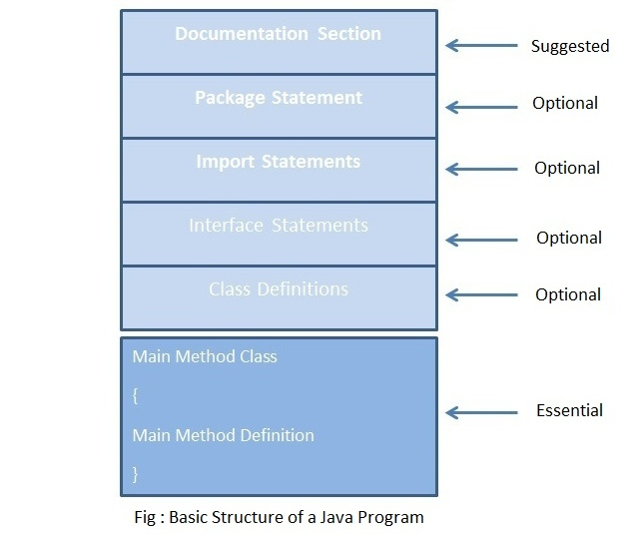
Structure of Java Program

Slide 17
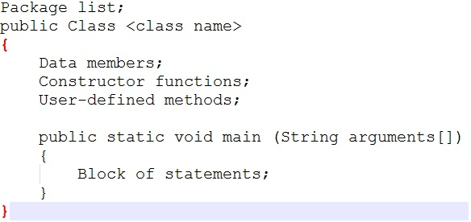
Structure of Java Program

Slide 18
Java Program Compilation

Slide 19
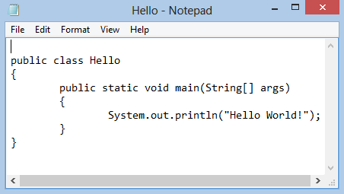
Hello World Java Program
World
Type the program and save the file with HelloWorld.java

Slide 20
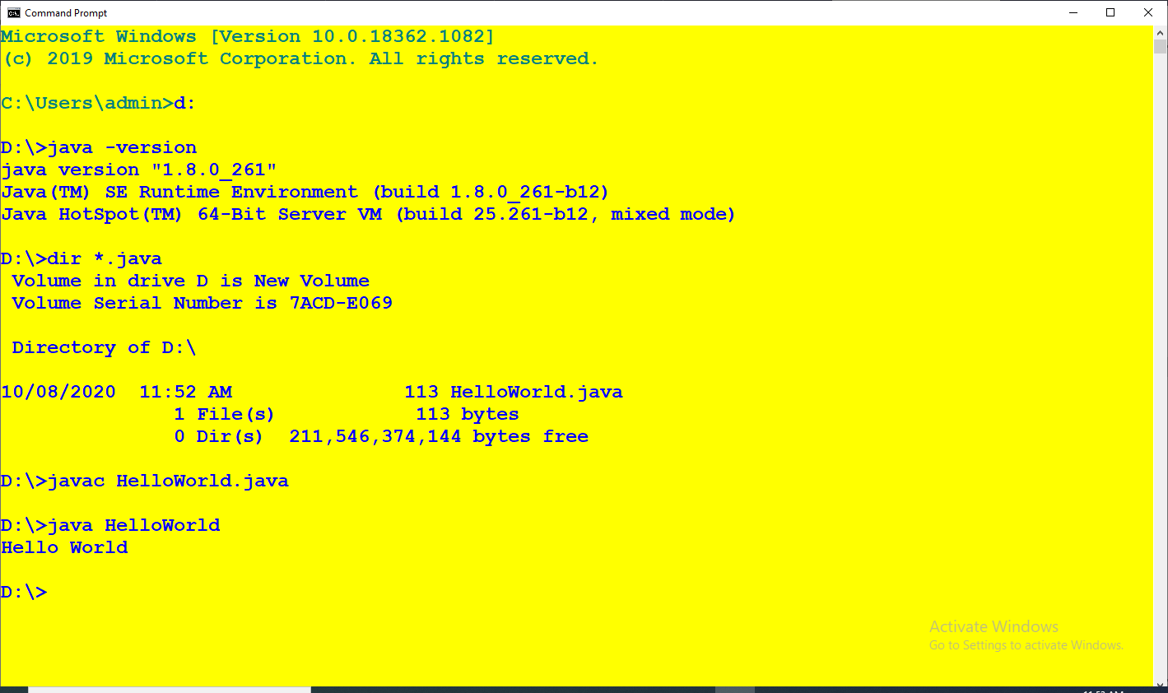
Manual Java Program Compilation
Compile the program using Java compiler javac
Run the program using Java interpreter java

Slide 21
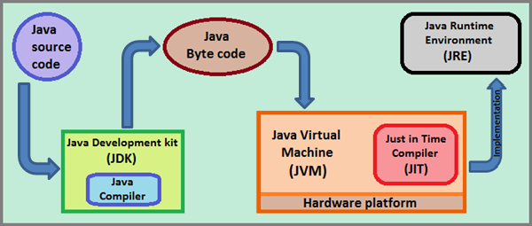
JAVA Program Compilation

Slide 22
Data Types in Java – Primitive data types
Default value
byte – 8 bits ( 1 Byte ) 0
short int – 16 bits ( 2 Bytes ) 0
int – 32 bits ( 4 Bytes ) 0
long int – 64 bits ( 8 Bytes ) 0
Float - 32 bits ( 4 Bytes ) 0.0f
double – 64 bits ( 8 Bytes ) 0.0d
bool – 1 – bit ( true or false ) false
char - 16 bits ( 2 Bytes ) \u0000

Slide 23
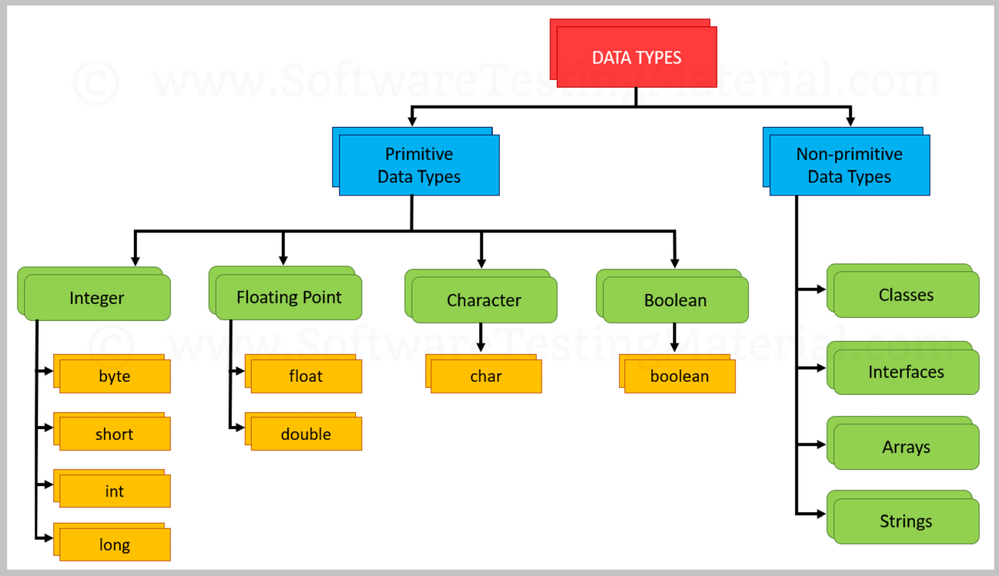
Data Types in Java – Primitive & Non – primitive

Slide 24
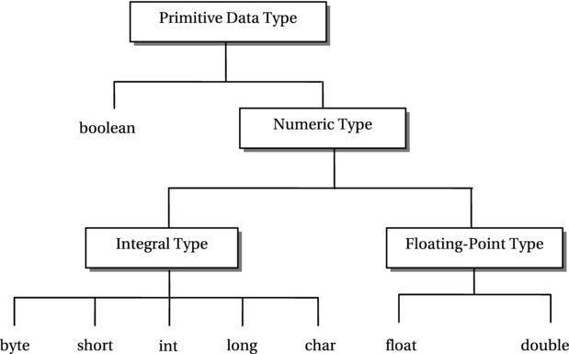
Data Types in Java – Primitive

Slide 25
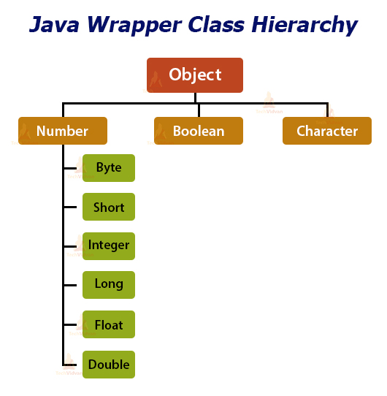
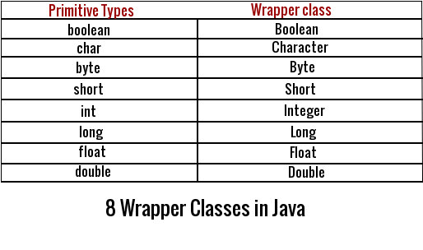
Wrapper Classes in Java

Slide 26
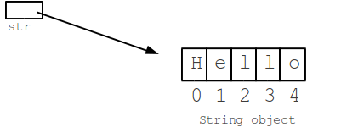
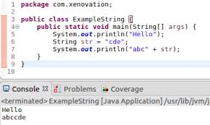
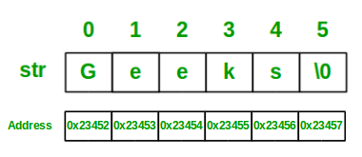
Strings – Non Primitive
String str=“Hello”;

Slide 27
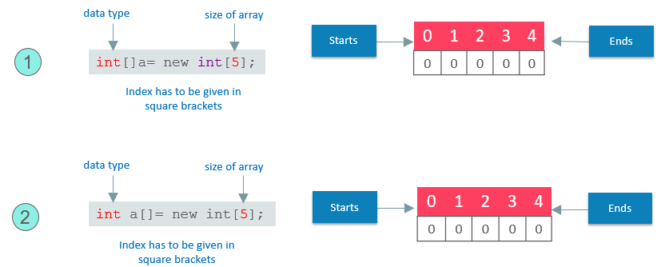
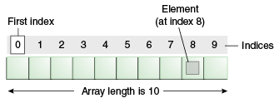
Arrays – Non Primitive
2 different ways to declare arrays
int array[ ] =new int[10];

Slide 28


Arrays – Alternative Declarations
The following declarations are equivalent:

Slide 29
int mycounter[ ]; // Array reference variable
mycounter = counter; // Reference variable assignment
int array[]=new int[]{3,2,17,19};
int myarray[];
myarray=array;

Slide 30
Array Declaration and Length attribute
int array[]=new int[10][20];
int myArray[];
myArray=array;
myArray[2][3]=20;
System.out.println(“Row Size of array is “ + array.length);
Row Size of array is 10 - Gives the row size
System.out.println(“Column Size of array is “ + array[0].length);
Column Size of array is 10 - Gives the column size

Slide 31
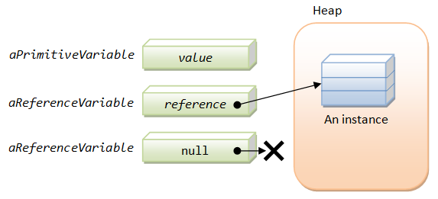
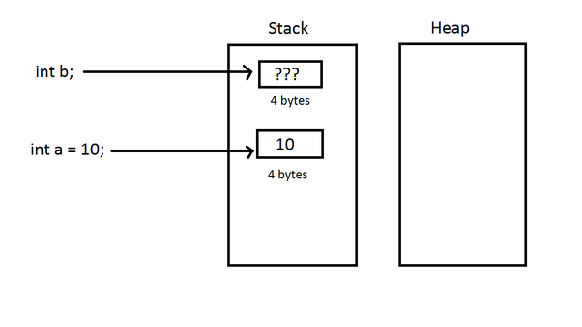
Primitive and Reference variables

Slide 32
Primitive variable and Reference variables
All Primitive and Reference variables are stored in Stack
All Objects of Non-primitive references are stored in
Heap

Slide 33
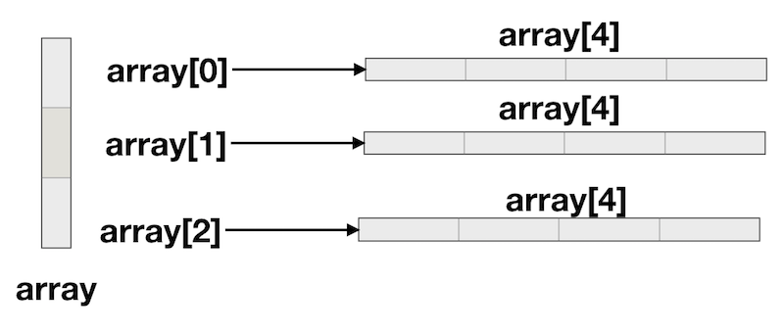
2-D Arrays
int array[][]=new int[3][4] ; // 3 by 4 array
Int myArray[ ][ ]= new int[ ][ ]{ {3,4,2,1}, {7,2,1,4} } ; // 2 by 4 array

Slide 34
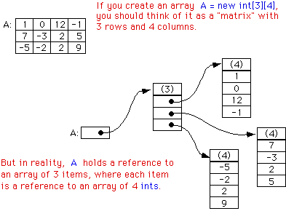
2-D Arrays
int A[][]=new int[3][4] ;

Slide 35
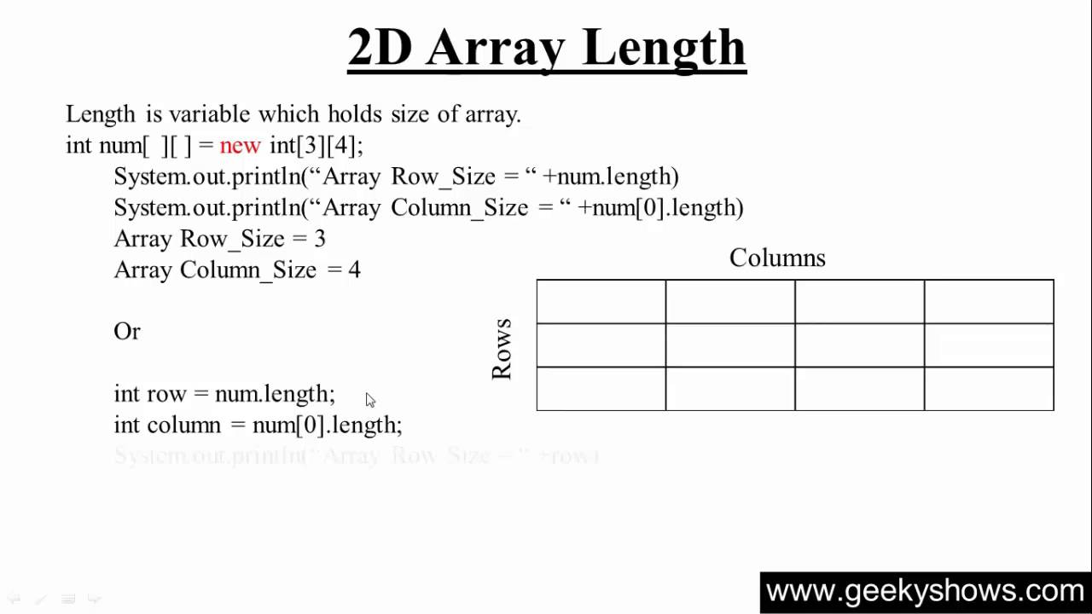

Slide 36
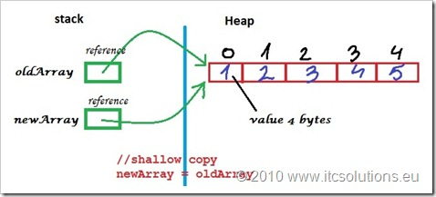
Array References
int oldArray[] = new int[]{1,2,3,4,5};
int newArray[] ; newArray=oldArray;

Slide 37
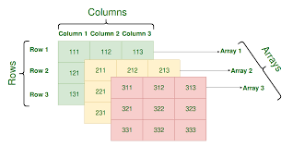
3-D Arrays
int array[ ][ ][ ]=new int[3][3][3] ;

Slide 38
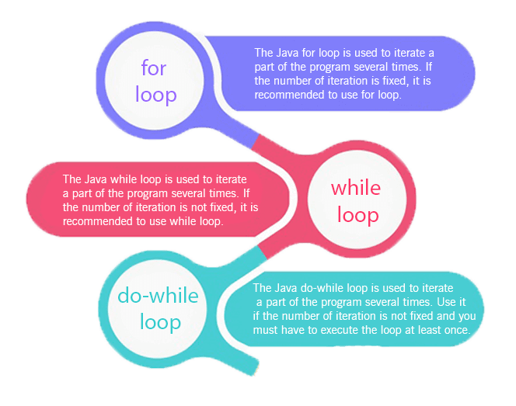
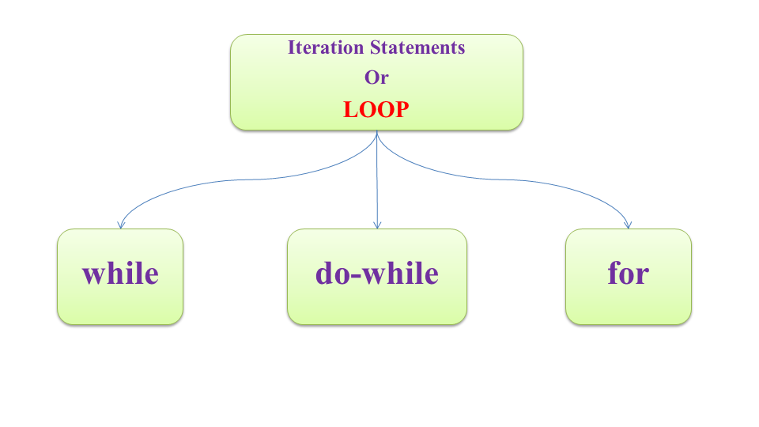
Loops in Java

Slide 39
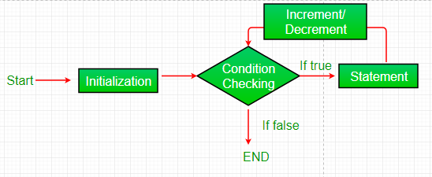
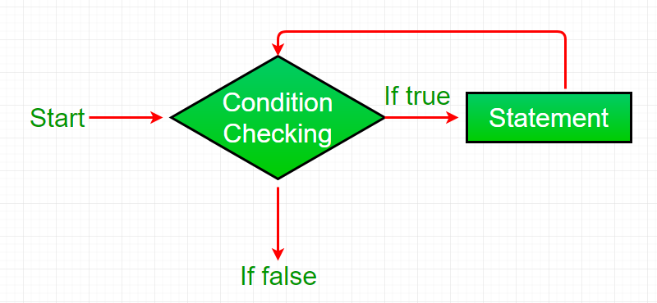
For and While - Loops in Java

Slide 40
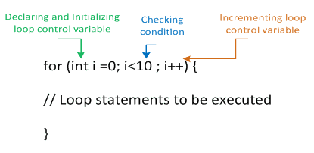
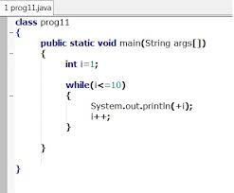
For and While - Loops in Java

Slide 41
JAVA – For each loop
class myTestclass {
public static void main(String[] args)
{
int array[]=new int[]{2,3,4,5,9};
for(int x : array) //For each loop
System.out.println(x);
}
}

Slide 42
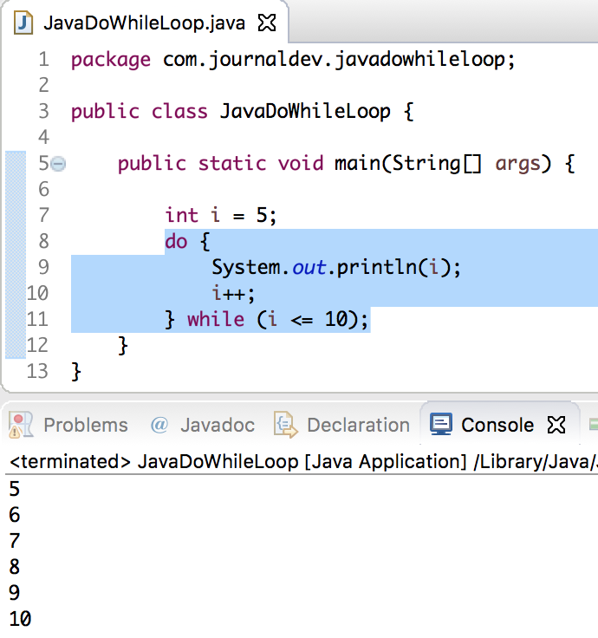
Do While Loop in Java

Slide 43
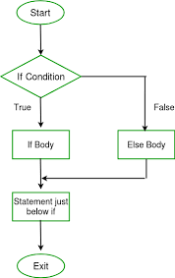
Control Statements – If Statement

Slide 44
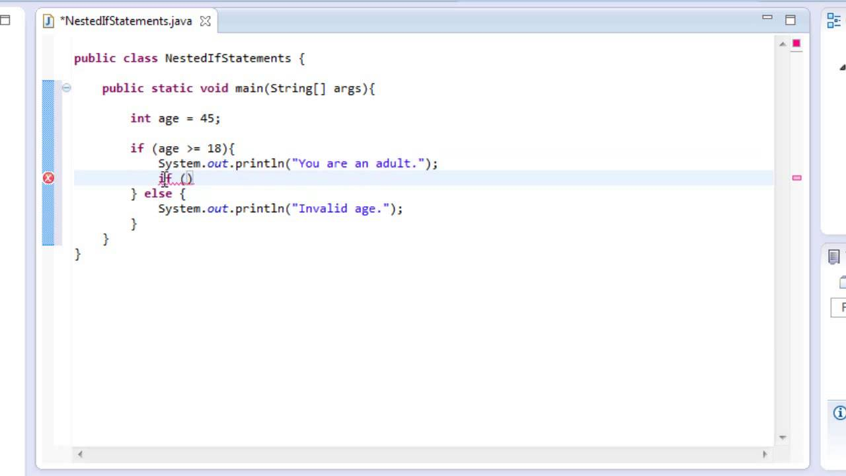
Control Statements – If Statement

Slide 45
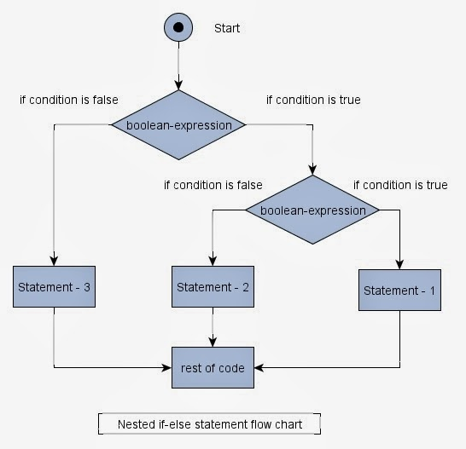
Control Statements – If Statement

Slide 46
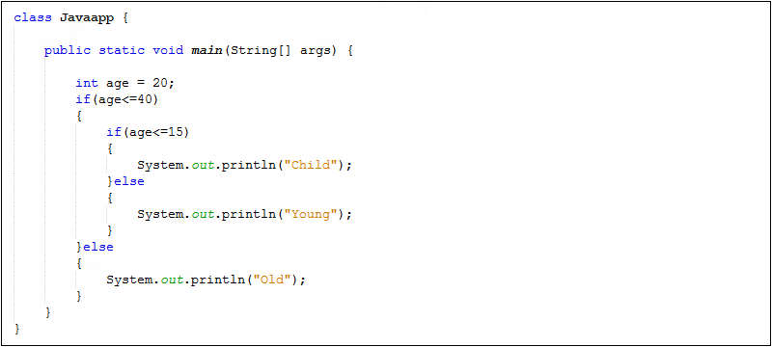
Control Statements – If Statement

Slide 47
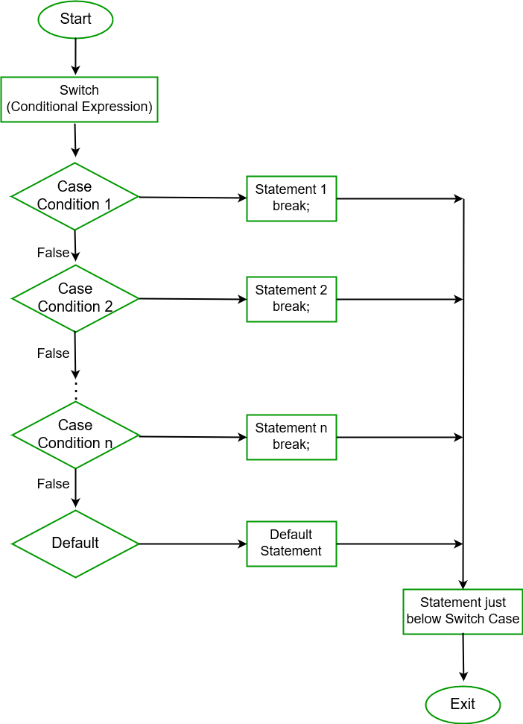
Control Statements – Switch Statement

Slide 48
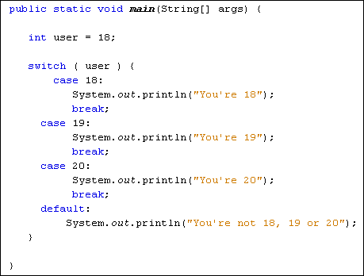
Control Statements – Switch Statement

Slide 49

Strings – in Java

Slide 50

Strings(Literals and Objects) – in Java
String s1 = “Hello; String s4=new String(“Hello”);
String s2 = “Hello”; String s5=new String(“Hello”);
String s3 = “Hello”;

Slide 51

Command Line Arguments

Slide 52

Command Line Arguments - Program

Slide 53

Command Line Arguments - Demo
Command line arguments

Slide 54
Thank You

